Slide 1



CVUSD: WIOA Program
Presented by: Generation Go! Staff

Slide 2

Generation Go! WIOA Program
Strengthen San Bernardino County’s Future Workforce
Chino Valley USD is partnering with San Bernardino County Workforce Development Department.
GenerationGo! is San Bernardino County’s exciting Workforce Innovation and Opportunity Act (WIOA) youth program.

Slide 3
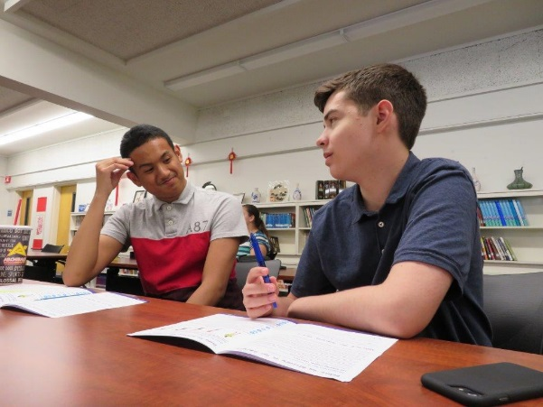
Generation Go!
Strengthen San Bernardino County’s Future Workforce
Through GenerationGO! the participant may be eligible for free skills and career exploration, free one-on-one mentoring, free career training and education, paid work experience, and many other free opportunities to prepare them for a lasting career.

Slide 4
Youth Eligibility
Strengthen San Bernardino County’s Future Workforce
Participant must be between the ages of 17-24 years old
Participant must be an out of school youth: not attending any secondary school or post secondary school
Participant has one or more barriers as identified by the case managers

Slide 5
Assistance with completing High School Diploma, GED or College registration
Strengthen San Bernardino County’s Future Workforce
Assistance with cost of high school diploma or GED testing
Assistance with completing the FASFA
Assistance with registering for College
Assistance with school supplies, extra cost for college books and health fees
Assistance with tutoring
We offer assistance with bus passes and gas cards for transportation to and from school and employment

Slide 6
GenerationGo! offers work experience, internships and career training with businesses in our community!
Strengthen San Bernardino County’s Future Workforce
Participants can receive 150- 200 hours paid work experience at $13.00 an hour.
Internships are available
Career Training

Slide 7
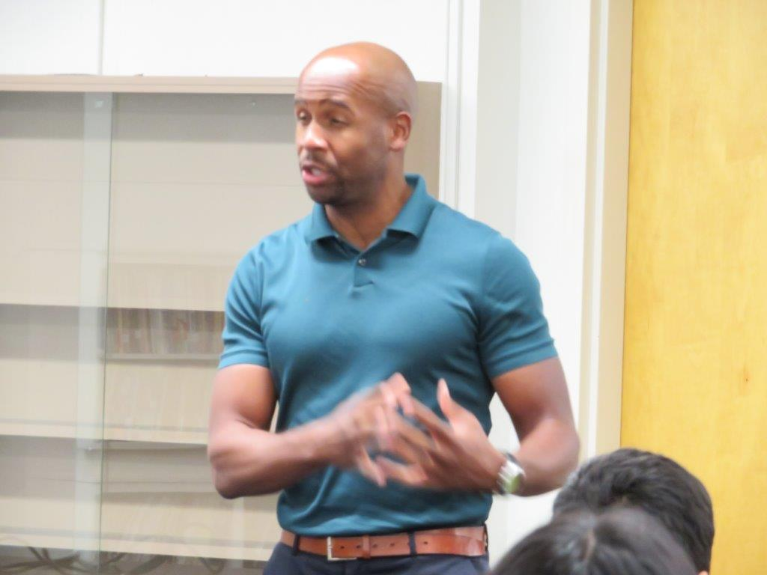
We offer workforce training that includes:
Strengthen San Bernardino County’s Future Workforce
Career assessments
Resume and cover letter building
Preparation for interview techniques
How to dress for success
Workforce etiquette

Slide 8
We offer classes in:
Strengthen San Bernardino County’s Future Workforce
Career Research
Financial Literacy
Sexual harassment in the workplace presented by Project Sister
Basic skills with our A-Game training
Labor laws presented by the U.S. Department of Labor
H & R Block
Mental Awareness “Ending the Silence” presented by District Nurse
On going life skill courses

Slide 9
GenerationGo! has 2 offices in the District to serve you
Strengthen San Bernardino County’s Future Workforce
Alternative Ed Center
15650 Pipeline Ave Room 11
Chino Hills, Ca 91709
909-628-1202
ext. 5311
Adult School
12970 Third Street
Room B
Chino, Ca 91710
909-628-1201 ext.8929

Slide 10
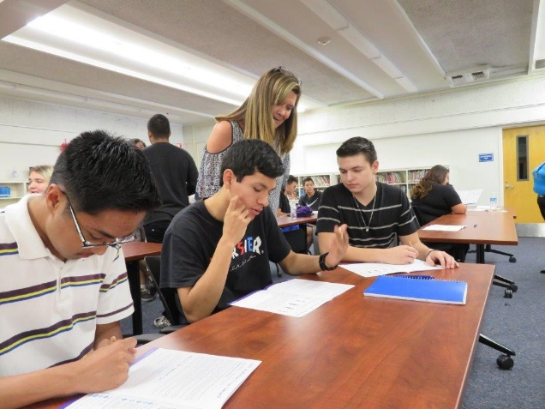
Here is what we can do for you
Strengthen San Bernardino County’s Future Workforce
We can assist you with completing your High School Diploma
We can assist you with getting your GED and help with the cost, we have a program on our Adult School Campus
We have counselors on site
We offer tutoring

Slide 11
GenerationGo! Offers Paid Work Experience
Strengthen San Bernardino County’s Future Workforce
We work closely with employers in our community
We have Youth currently working at:
Chino Café
Staples
Smart and Final
Petco
International Hair Design
Hussmann Corporation
Three Way Thrift Store
Marshalls Department Store
TJ Maxx Department Store
Chino Chamber of Commerce

Slide 12
Assistance to enroll in College or Advance Training programs
Strengthen San Bernardino County’s Future Workforce
We work closely with Chaffey College, Mt. Sac College, Vocational and Career Schools
We will assist you with registration and enrollment
We will assist you with filling out your Financial Aid (FASFA)
We will reimburse you for college books, school supplies and college health fees
We will guide you to Programs on the college campuses that will offer you assistance that best fits your needs: EOPS, transitional assistance, Assess office, writing and math labs, etc.

Slide 13
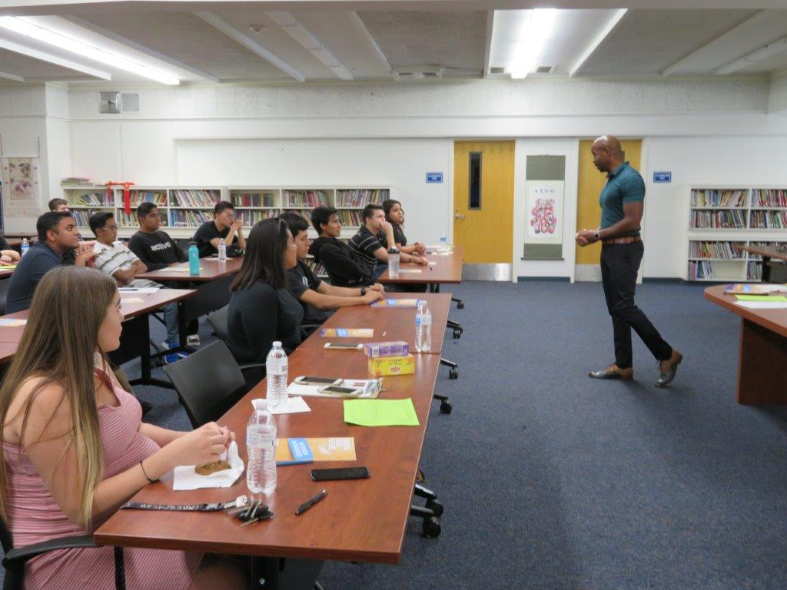
We offer assistance enrolling you in courses in:
Strengthen San Bernardino County’s Future Workforce
Construction Trade
Health Care
Computer Health Systems
Transportation and Logistics
Office Occupations
Manufacturing
HVAC classes
EMT classes
Child Development Classes

Slide 14
We have other services to offer you
Strengthen San Bernardino County’s Future Workforce
Bus passes or gas cards to help support transportation needs to and from school and employment
Help with work clothing or uniforms
Help with school supplies
Gift cards to purchase hygiene products
Gift cards to purchase interview outfits.
We offer incentives for attending our workshops and completing your High School Diploma or receiving your GED

Slide 15

Here is what you need to do:
Strengthen San Bernardino County’s Future Workforce
Meet with one of our Case Managers and see if you qualify for the
GenerationGo! Program

